Slide 1

Agentic AI Master Class
Build Smarter Autonomous AI Systems
Starting Date : November 24,2025
Time : 8:00 PM IST to 10:00 PM IST
Powered by PurpleSkill & SpanLabs

Slide 2
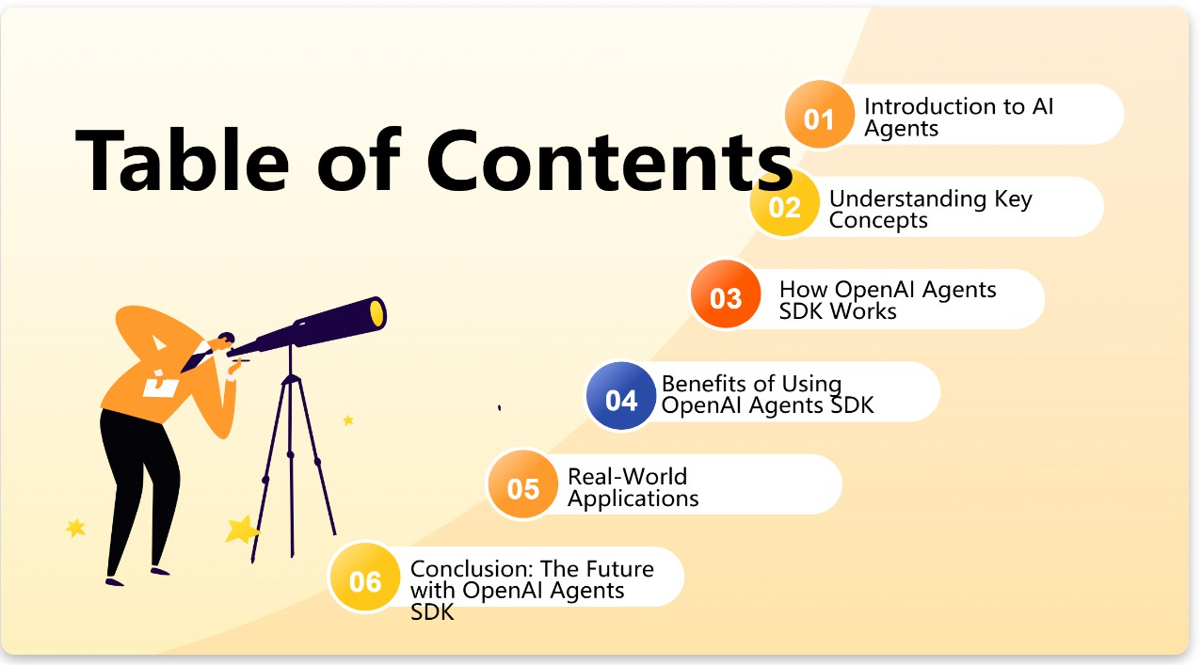


Slide 3
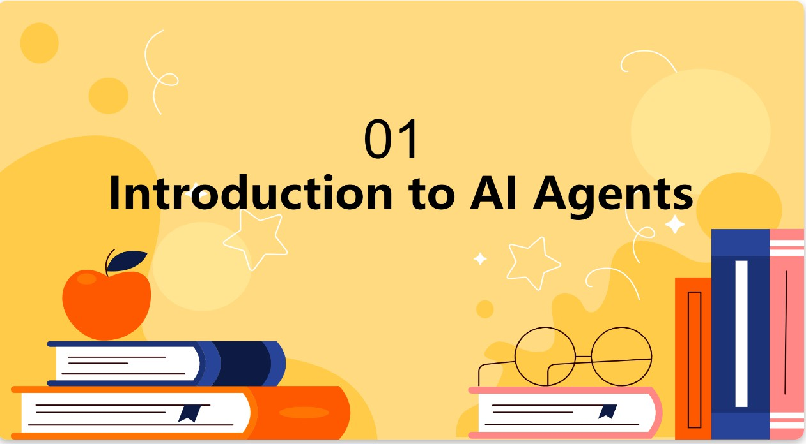

Slide 4
What is Agentic AI?
Is a type of ARTIFICAL INTELLGIENCE
Is a system
that can automate tasks
adjust its behavior, and
take action without needing step-by-step instructions

Slide 5
Examples
In retail, agentic AI can automatically adjust prices in real-time based on competitor pricing, customer demand, and inventory levels.
It learns from this data and optimizes itself to make smarter decisions—like knowing when to increase stock of a high-demand product or suggest relevant items to a shopper based on their past behavior.

Slide 6
Agentic AI Stats That Will Blow Your Mind!
50% of companies currently using generative AI models will launch agentic AI pilots or proof of concepts by 2027.
33% of enterprise software applications will include agentic AI by 2028.
1 billion AI agents are expected to be in use by 2026. (Marc Benioff, Salesforce)
80% of customer service issues will be resolved by AI agents without human intervention by 2029.
64% of respondents believe that agentic AI will improve customer service outcomes.
75% of software engineers will use agentic AI coding assistants by 2028.
15% of workplace decisions will be made using agentic AI by 2028.
$150 billion could be saved in the US healthcare sector by 2026 through agentic AI applications.
Global spending on AI will reach $632 billion by 2028, with a focus on agentic AI.
Agentic AI is expected to drive about 3.5% of global GDP by 2030.

Slide 7
KEY FEATURES
Autonomy: AI agents can operate independently, making decisions based on available data without requiring constant human intervention.
Learning and Adaptability: One of the most powerful traits of AI agents is their ability to learn from data and experiences
Goal-Oriented: AI agents are designed with specific objectives in mind. Whether it’s increasing sales, enhancing customer experience, or improving operational efficiency, AI agents work towards achieving these goals with minimal human oversight.

Slide 8
KEY FEATURES continued
Interactivity: AI agents can engage with users, customers, or other systems, collecting information and responding in real-time. T
Autonomous Communication: Many AI agents can communicate with other systems and agents, creating a network of decision-making units that work together. For example, AI agents can update inventory systems, sync with pricing tools, or communicate with CRM platforms to ensure everything runs smoothly.

Slide 9
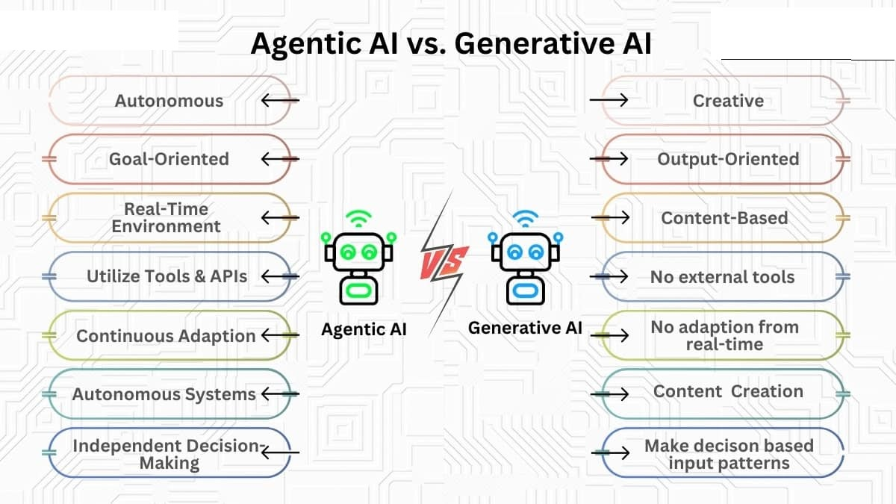
GEN AI vs AGENTIC AI

Slide 10
Types of Agents
Reactive agents: Respond to immediate inputs but don’t learn from them.
Learning agents: Learn from data and improve over time.
Hybrid agents: A combination of both reactive and learning agents, adapting to situations as they unfold.

Slide 11
Types of Agents
Rule-Based Systems/Agents
Low Autonomy, Low Control
Workflow Agents
Low Autonomy, High Control
Semi-Autonomous Agents
Moderate to High Autonomy, Moderate Control
Autonomous Agents
High Autonomy, Low Control

Slide 12
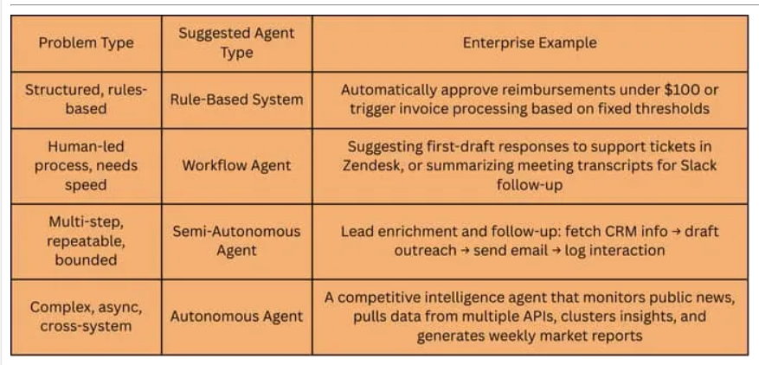

Slide 13
How Agentic AI Works?
Perception
Agentic AI begins by collecting data from its environment through sensors, APIs, databases or user interactions
Reasoning
Once the data is collected, the AI processes it to extract meaningful insights. Using natural language processing (NLP), computer vision or other AI capabilities, it interprets user queries, detects patterns and understands the broader context.
This ability helps the AI determine what actions to take based on the situation.

Slide 14
How Agentic AI Works?
Goal setting
The AI sets objectives based on predefined goals or user inputs. It then develops a strategy to achieve these goals, often by using decision trees, reinforcement learning or other planning algorithms.
Decision-making
AI evaluates multiple possible actions and chooses the optimal one based on factors such as efficiency, accuracy and predicted outcomes. It might use probabilistic models, utility functions or machine learning-based reasoning to determine the best course of action.

Slide 15
How Agentic AI Works?
Learning and adaptation
After executing an action, the AI evaluates the outcome, gathering feedback to improve future decisions. Through reinforcement learning or self-supervised learning, the AI refines its strategies over time
Orchestration
AI orchestration is the coordination and management of systems and agents. Orchestration platforms automate AI workflows, track progress toward task completion, manage resource usage, monitor data flow and memory and handle failure events

Slide 16
Agent OPS?
Team who will be managing Agent lifecycle
They will play role in
Selecting best model based on need
Auditing model and working
Monitoring

Slide 17
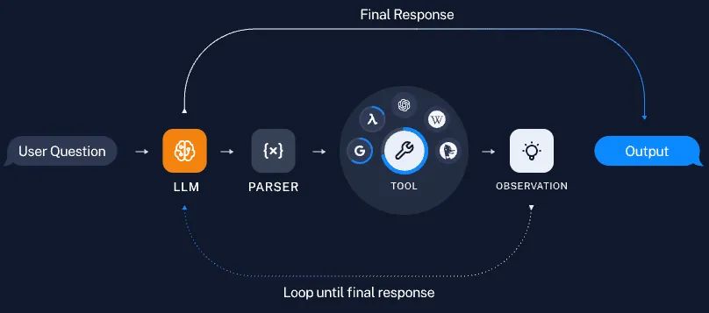

Slide 18
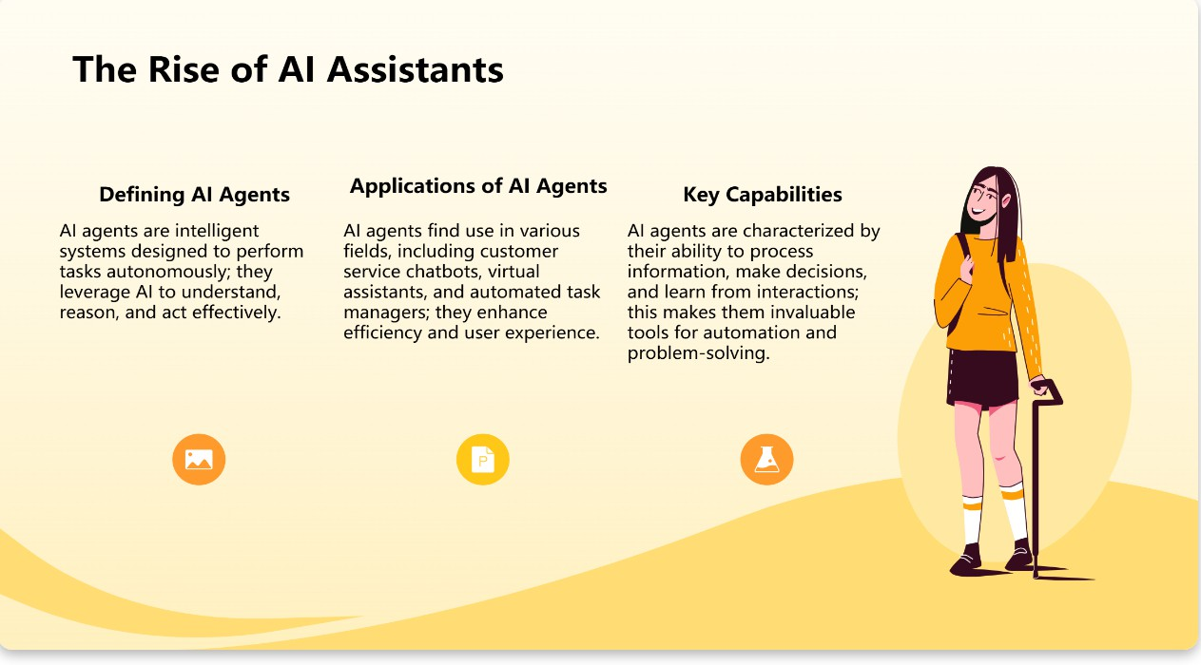

Slide 19
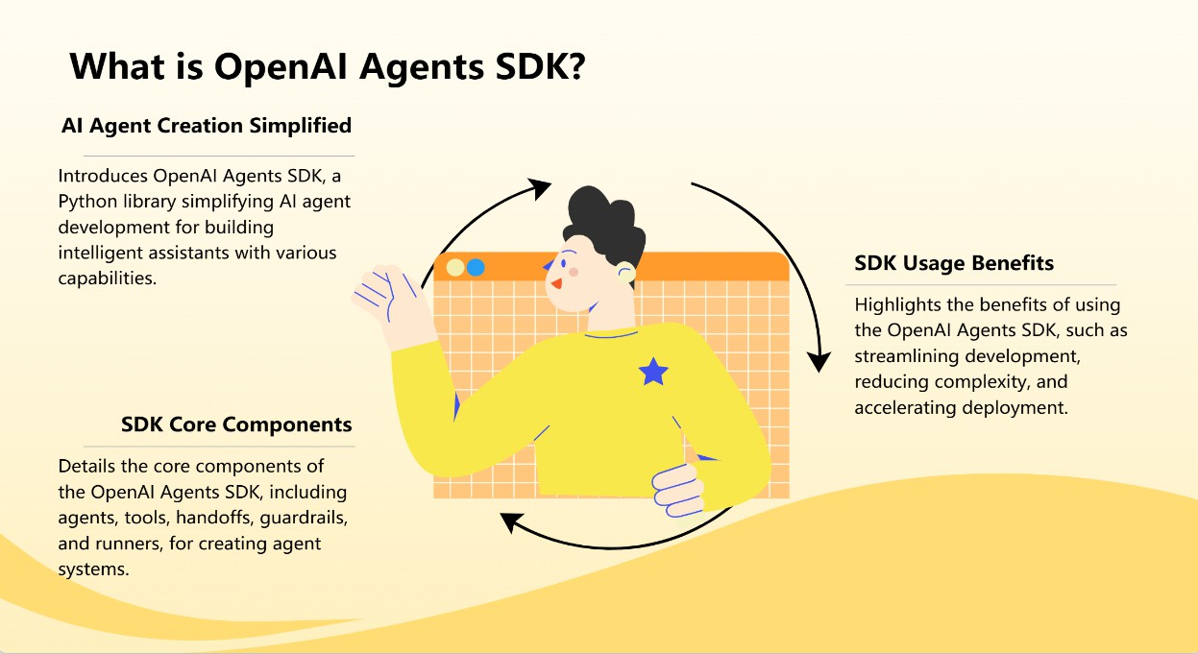

Slide 20
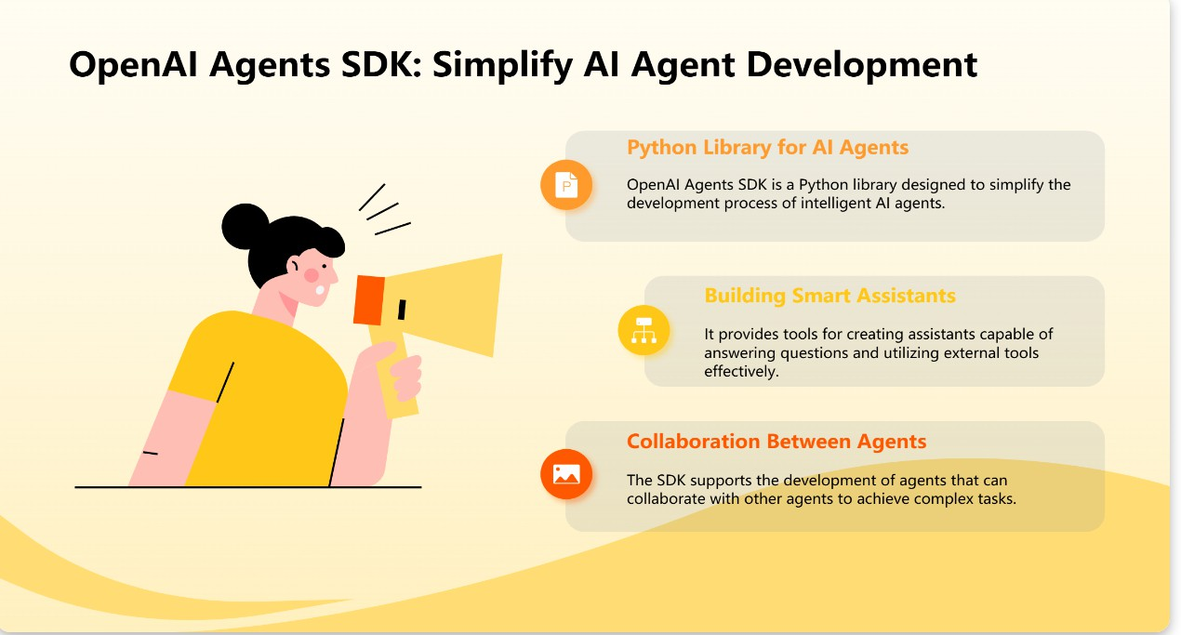

Slide 21
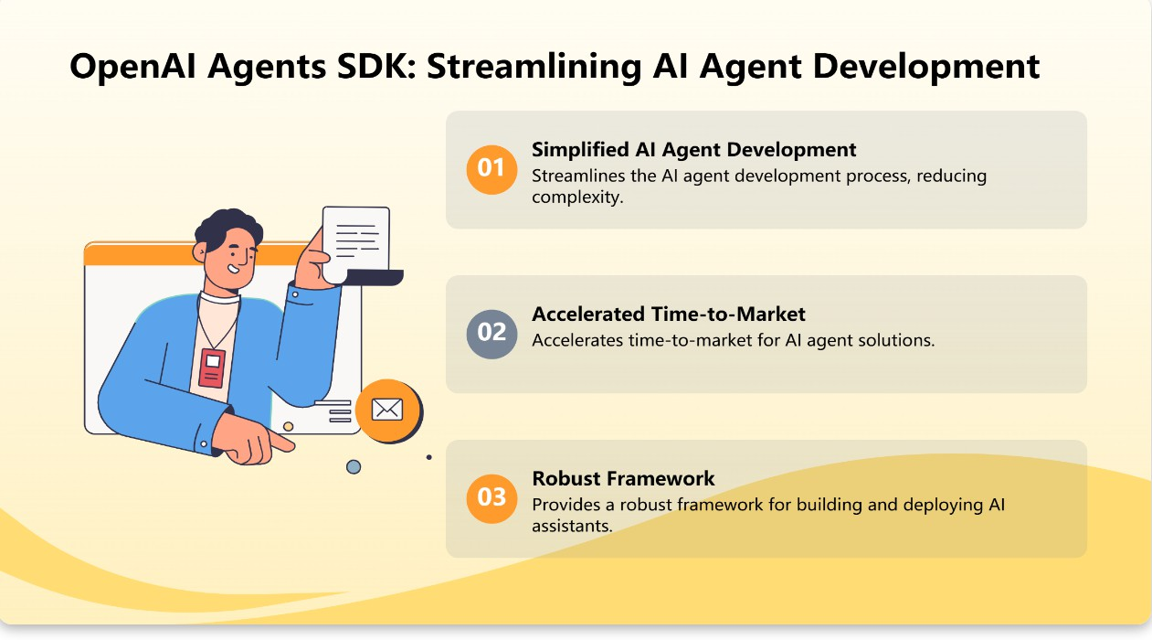

Slide 22
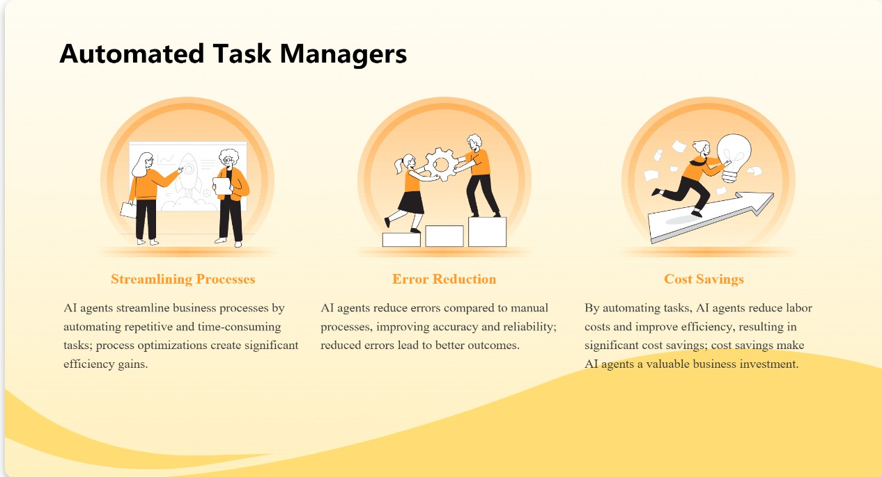

Slide 23
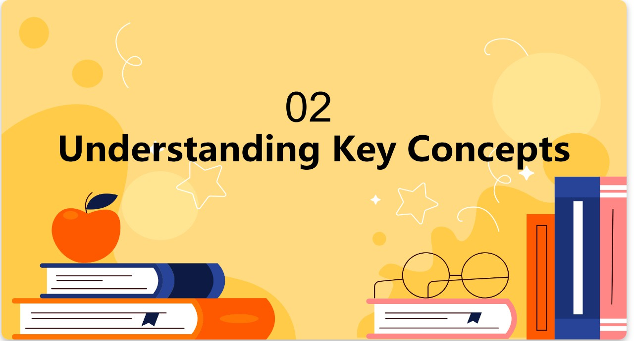

Slide 24
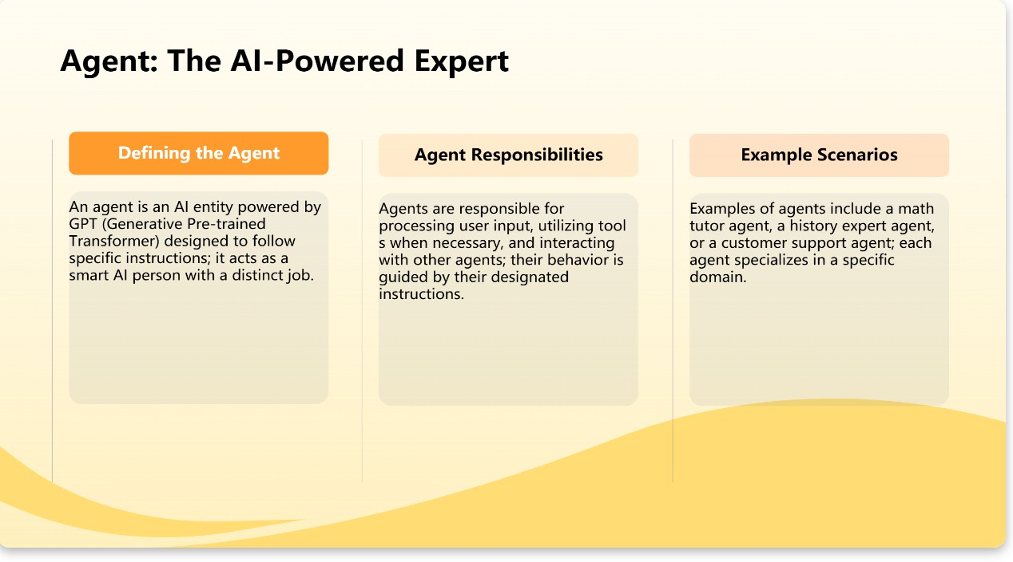

Slide 25
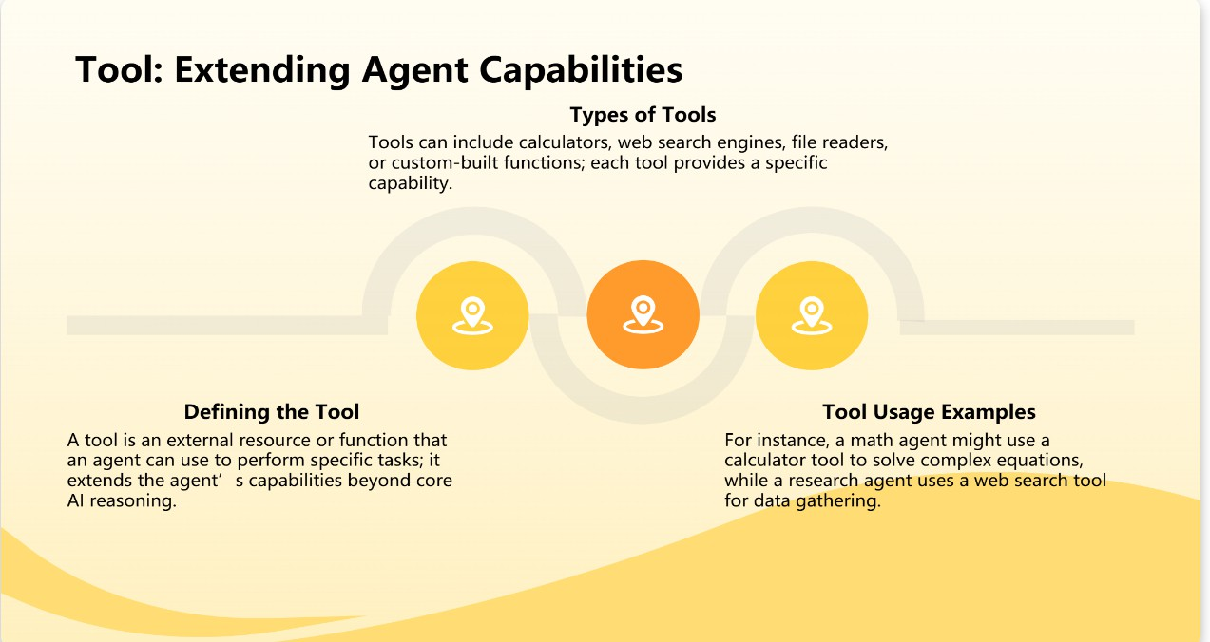

Slide 26
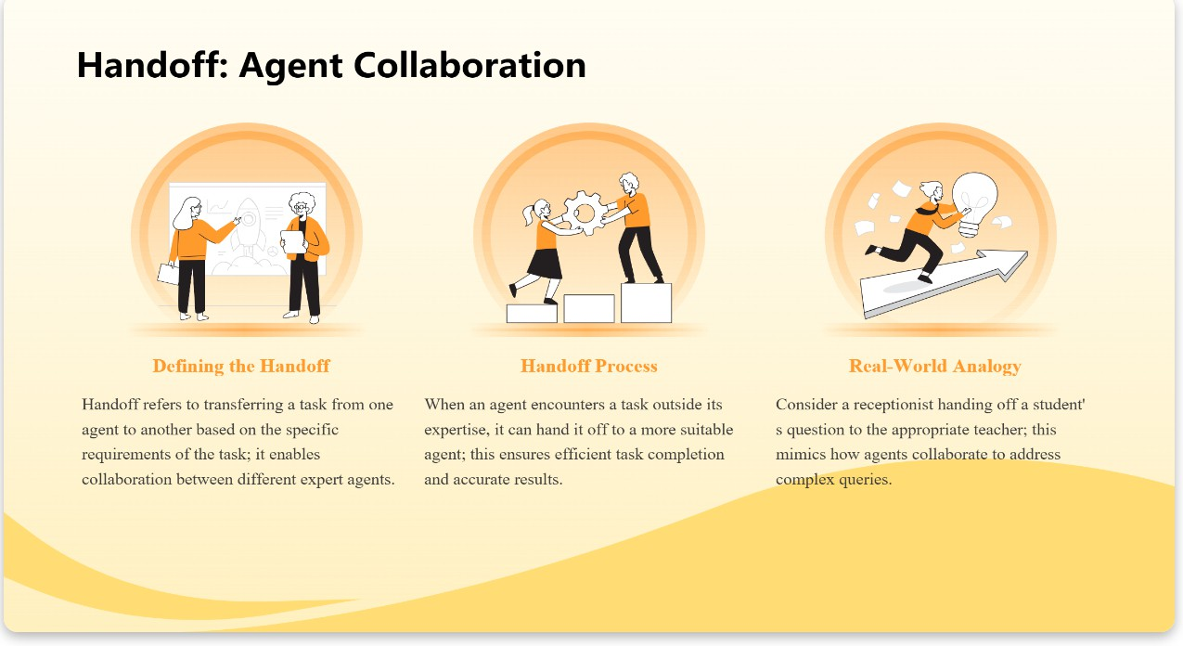

Slide 27
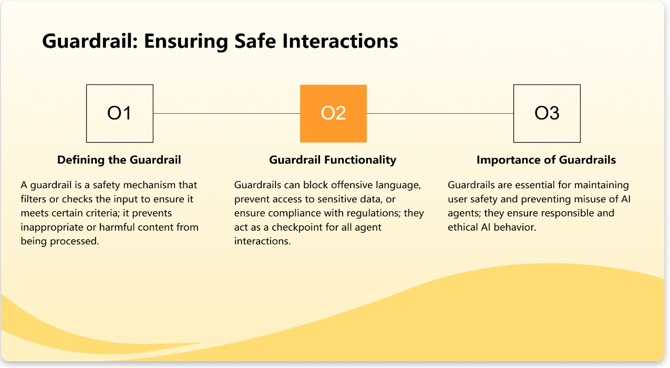

Slide 28
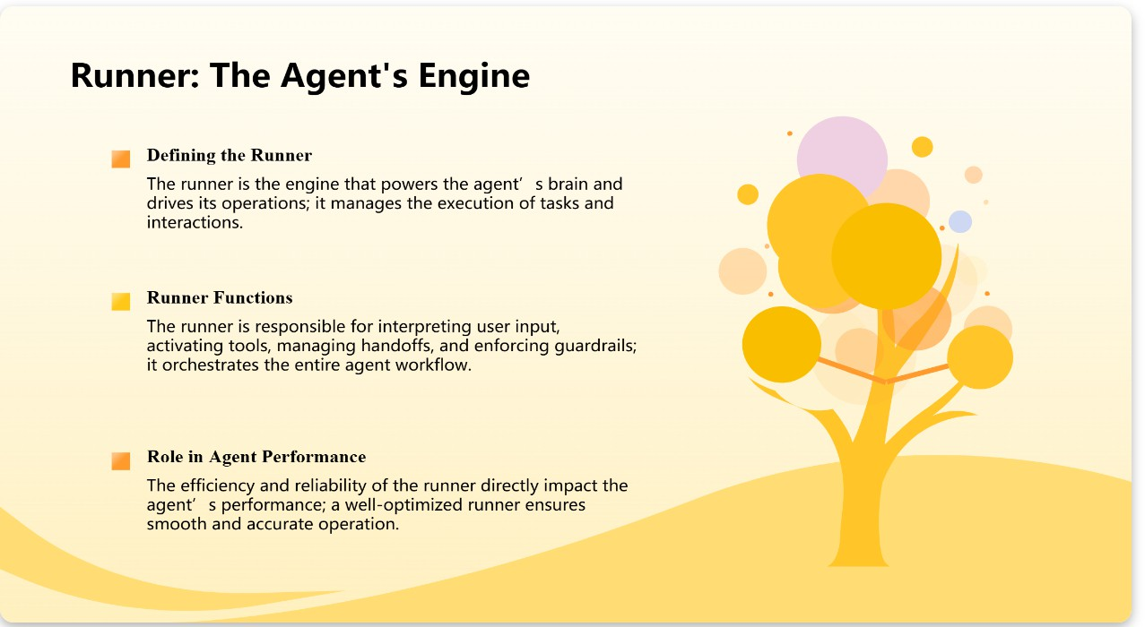

Slide 29
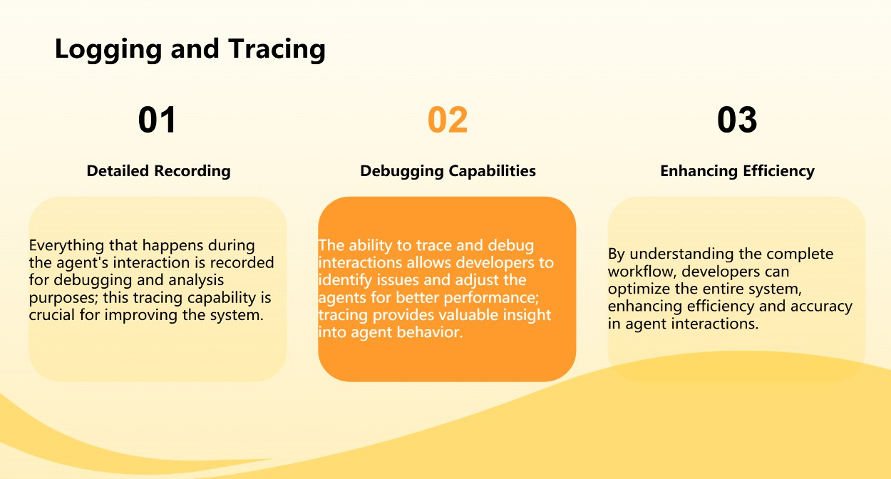

Slide 30
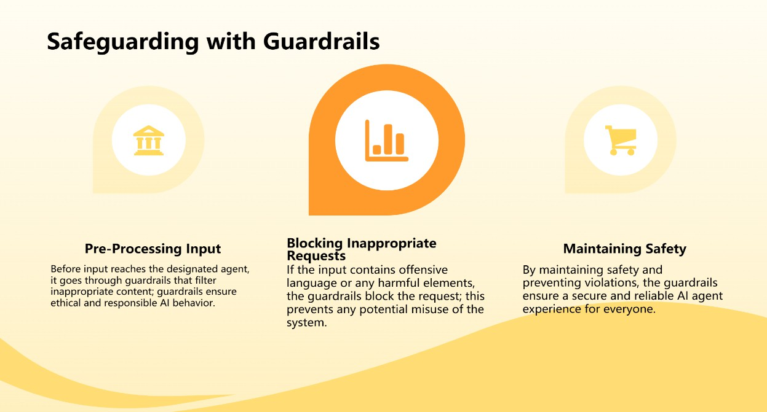

Slide 31
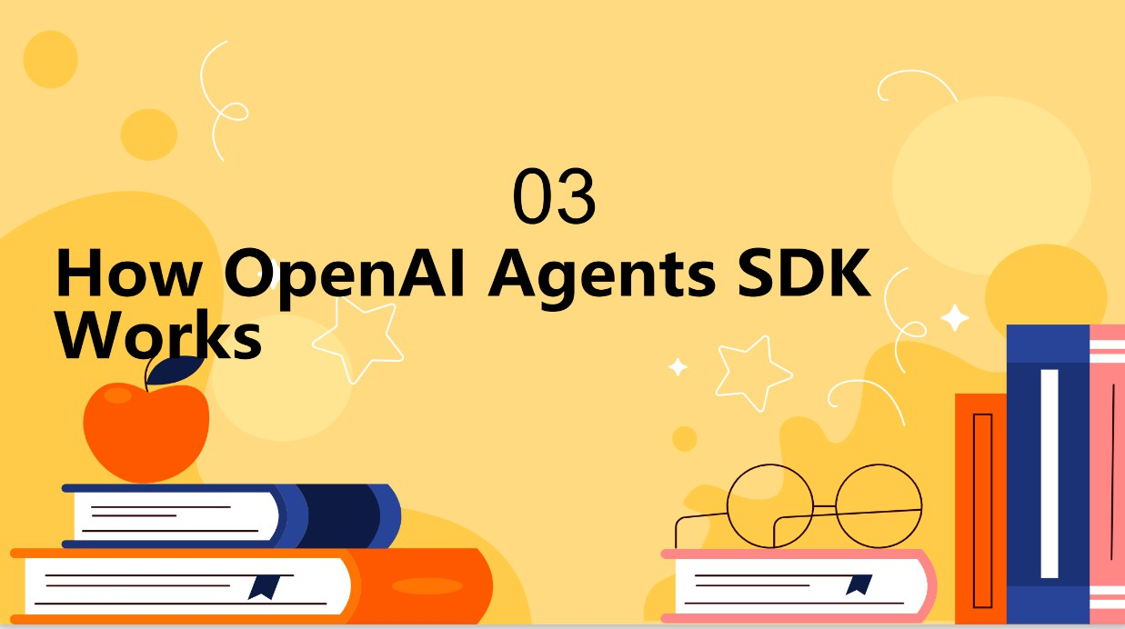

Slide 32
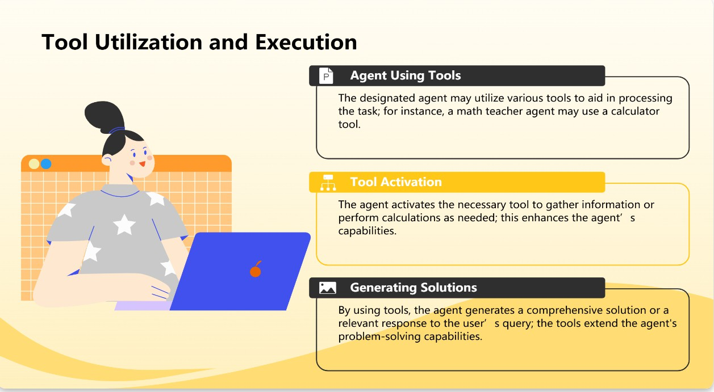

Slide 33
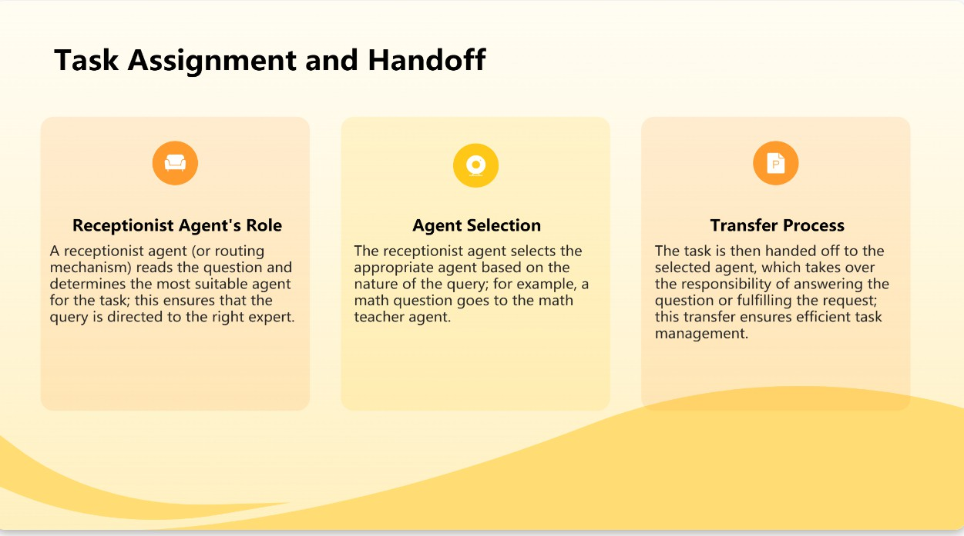

Slide 34
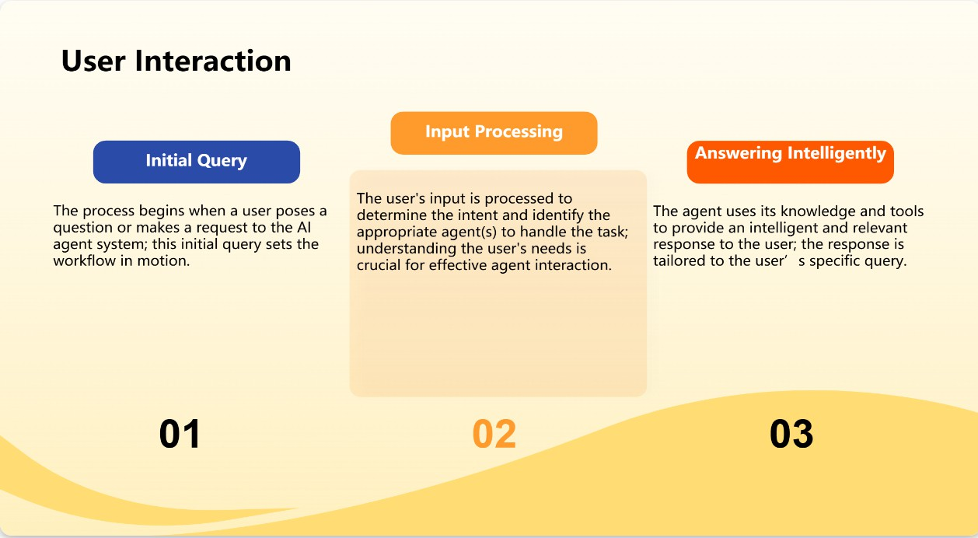

Slide 35
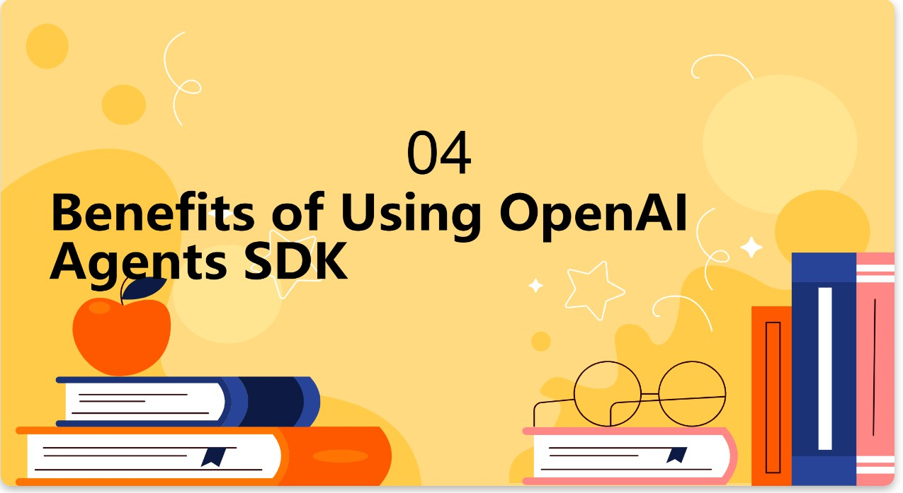

Slide 36
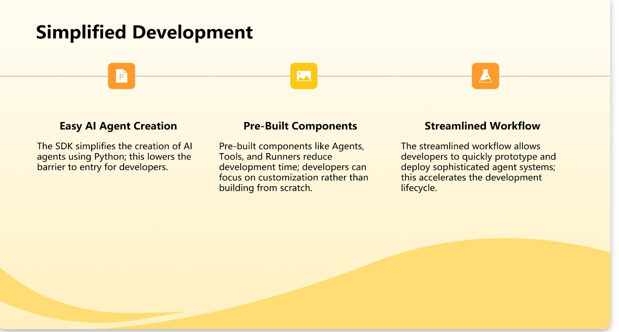

Slide 37
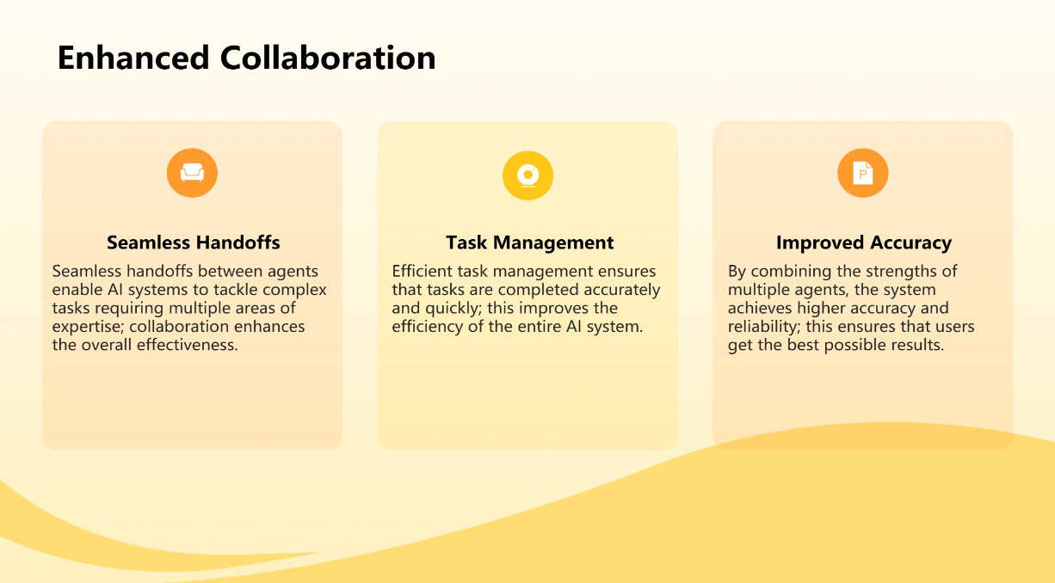

Slide 38


Slide 39
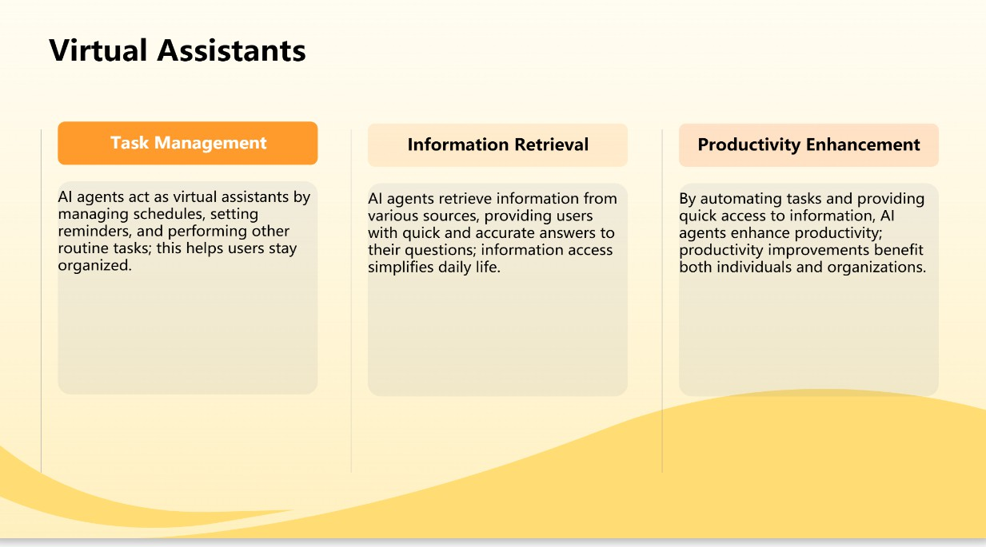

Slide 40
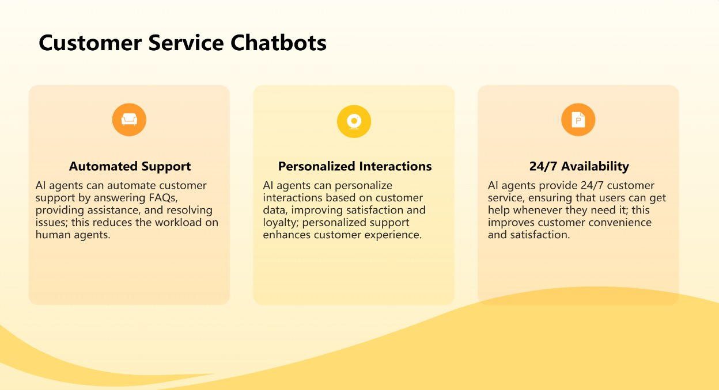

Slide 41
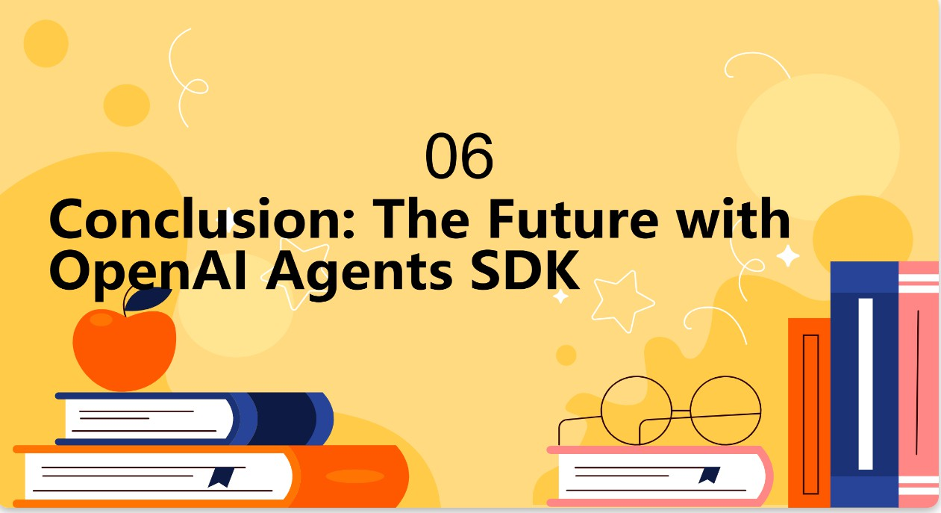

Slide 42
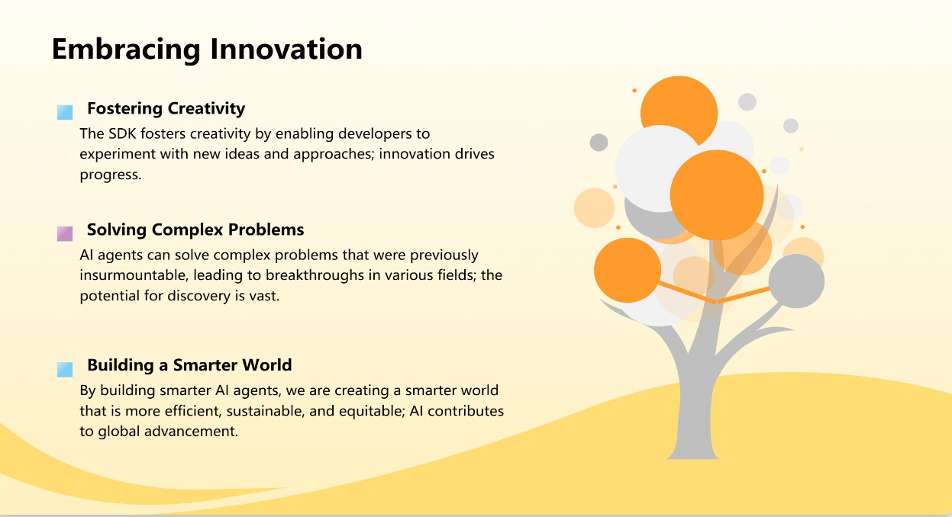

Slide 43
